Slide 1
Reviewing Meta-Analysis by Summarizing Three Articles
Presented by
Mohamad Abukela ,Tamader Alballa,
and Kevin Bembridge
Under the Supervision of
Prof. William Rice and Prof. Valbona Bejleri

Slide 2
OUTLINE
Objectives
Applications of Meta-Analysis
Review of the Literature
Our consulting services
Acknowledgements

Slide 3
Applications of meta-analysis
Meta-analysis is an important tool and a prime source of information for evidence based nutrition, health medicine, and economic evaluation.
Example 1: Nutrition
How much of each nutrient do pregnant women consume?
Are pregnant women deficient in any of these nutrients?
Example 2: Health medicine
Example 3: Epidemiology
Example 4: Education.

Slide 4
Definition of epidemiology:
“Epidemiology is the study of the distribution and determinants of health–related states or events in specified populations and the application of this study to the control of health problems.”
John Last. Dictionary of Epidemiology 1995

Slide 5
Literature Review
What is Meta-analysis? Crombie, Iain and K.Davies, Huw TO. www.whatisseries.co.uk.
Berman, N.G., and R.A. Parker (2002). Meta-analysis: neither quick nor easy. BMC Medical Research Methods.
Shachar, Mickey (2008). An analysis of “Meta-Analysis: The preferred method of choice for the assessment of distance learning quality factors”.

Slide 6
Meta -analysis As a Statistical Technique
Presented by
Mohamad Abukela

Slide 7
Basic Concepts & Principles:
Meta-analysis
Is a statistical technique used to combine the findings from independent studies, most often clinical trials.
Is used to assess the clinical effectiveness of the healthcare intervention and to provide estimate of the treatment effect.
Is based on the robustness of the systematic review and its quality depends on how much it covers all relevant studies.
Provides a quantitative estimate of the aggregated over all relevant studies, looks for the presence of heterogeneity, and uses sensitivity analysis.
* Meta-analyses is now a hallmark of evidence-based medicine.

Slide 8
What is systematic review methodology?
Systematic review stresses the need to take great care to find all the relevant studies (published and unpublished).
Systematic review aims for in-depth assessment of the study design and examines the implementation of each study separately to see how carefully the objectives of the study have been followed and how its methodology has been carried out.

Slide 9
Meta-analysis
Statistical techniques
Since,
meta-analysis takes data (result findings) from several different studies and produces a single estimate of the effect, usually of a treatment, intervention or risk factor
Therefore,
it is necessary for us prior doing meta-analysis to look at study participants, interventions, risk factors, and settings in which the studies were carried out, and decide whether they are sufficiently similar for us to say that there is something in common for us to investigate or not !

Slide 10
Meta- analysis consists of
three main parts:
A pooled estimate and confidence interval for the treatment effect after combining all the studies.
A test for whether the treatment or risk factor effect is statistically significant or not.
(does the effect differ from no effect more than would be expected by chance?)
A test for heterogeneity of the effect on outcome between the included studies.
(does the effect vary across the studies more than would be expected by chance?)

Slide 11
Heterogeneity
Studies differ in terms of:
Participants
Interventions
Outcome definition
Study design
These factors produce
Clinical Heterogeneity
This means that the clinical question addressed by these studies is NOT the same for all of them. We detect clinical heterogeneity from the descriptions of the trial population, treatments, outcome measurements.

Slide 12
Heterogeneity -continued-
Statistical Heterogeneity
Statistical heterogeneity may be caused by clinical differences between studies, i.e. by clinical heterogeneity , by methodological differences, or by unknown characteristics of the studies, or by study populations.
There are some statistical techniques test that have been developed to check for the heterogeneity like:
Cochran’s Q, a statistics based on chi-squared test. .
I^2 which scores heterogeneity between 0% and 100%

Slide 13
Sensitivity analysis
Because of the many ways in which decisions taken about selection, inclusion and aggregation of data may affect the main findings, it is usual for meta-analysis to carry out sensitivity analysis.
This statistical procedure explores the ways in which the main findings are changed by varying the approach to aggregation.

Slide 14
Sensitivity analysis -continued-
A good sensitivity analysis will explore among other things:
The effect of excluding various categories of studies; for example, unpublished studies or those of poor quality.
2. It may also examine how consistent the results are across various subgroups.

Slide 15
Meta-analysis:
Neither quick nor easy
BMC Medical Research Methods
Presented by
Tamader Alballa

Slide 16
Introduction
Meta-analysis
Is helpful in literature review, specifically, in summarizing findings of multiple studies.
It considers analysis of large amounts of data from numerous separate studies in order to integrate such diverse data into one research.
Berman and Parker (2002)

Slide 17
Procedure of meta-analysis
Define objectives of analysis, including topic of interest and whether the analysis should provide summary of findings or variability between studies.
Identify a clear inclusion criteria.
Meta-analysis also requires definition of clear type of studies that will be analyzed, and it might include different types of studies even though randomized trials are believed to be the most reliable while case reports provide the weakest evidence.

Slide 18
Procedure of meta-analysis -continued-
Characteristics of patients can also have serious impact on findings of meta-analysis; need to ensure maximal diversity of patients in terms of gender, age, ethnicity and other characteristics.
Meta-analysis requires clearly determined treatment modalities and methods that are allowed for measuring outcomes of treatment.

Slide 19
Procedure of meta-analysis -continued-
Berman and Parker (2002) argue that review of abstracts can help to exclude non-relevant studies and trials. The collected data has to be abstracted according to predetermined criteria and instructions.
Findings can be reported with the help of visuals and summaries while interpretation must rely solely on p-value and should take other characteristics into consideration.

Slide 20
Summary
Meta-analysis is not an easy procedure, it requires large investments of time.
Controversies associated with meta-analysis, specifically, about homogeneity of studies that have to be analyzed.
Meta-analysis is a very helpful tool because it allows to obtain and process data on population significantly greater than that researched in separate studies.

Slide 21
An analysis of “Meta-Analysis:
The preferred method of choice
for the assessment of
distance learning quality factors”
Presented by
Kevin Bembridge

Slide 22
The purpose of this paper is to speak about the use of meta-analysis (MA) by introducing the reader to concepts, procedures, and issues underlying the method.
The author recommends finding few different articles to cover the research. The researcher should find research for and against the topic. The researcher should note the timeframe.

Slide 23
Important Things to Note
The papers chosen should not be inconclusive.
A paper should not have extraneous variables.
If a subject was not randomly selected, it can truly affect any research.
When doing a MA research, the project should be refine, not broaden, and the null-hypothesis should be eliminated.

Slide 24
Things to look for:
When reading the papers, the researchers are looking for specific things.
Common ground
Common denominator
Each study has to be transforming to a common metric called an effect size (ES).

Slide 25
A table is needed which should include
Author
Year publish
Topic
Time frame
Number of studies
Number of subjects
Effect Size (ES).

Slide 26
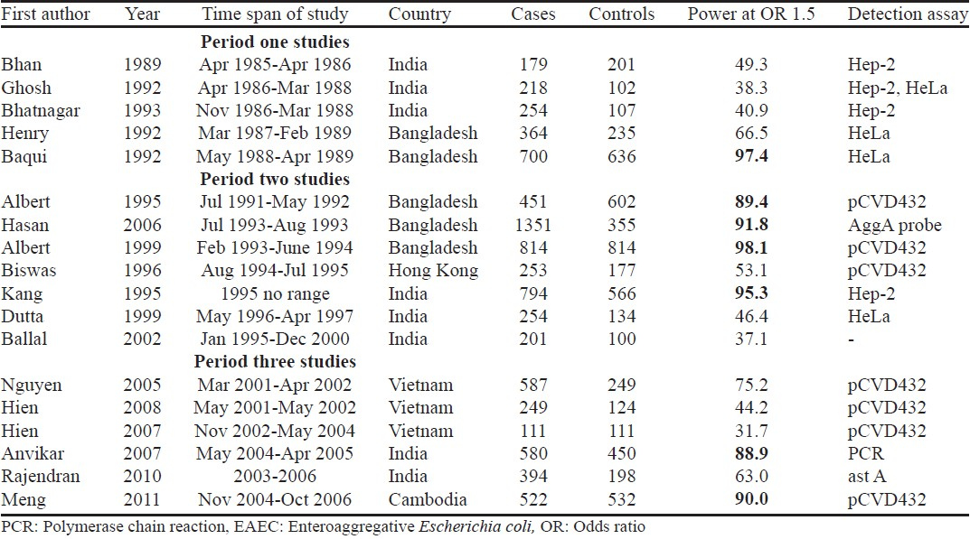
Example of table

Slide 27
The researcher also should check the method/mode of the deliveries
The time covered
The control group
If the article has sufficient quantitative data or not, then that has to be known

Slide 28
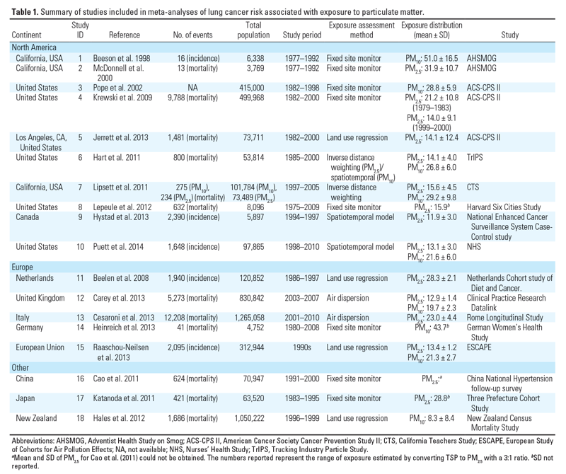

Slide 29

Conclusion
Which Effect Size (ES) should be used is also important.
The ‘g effect’ by Hedges and Olkin (1985) or ‘d effect’ should be considered.
Where mean 1 is the experimental group and mean 2 is the control group. The standard deviation is of the pool total.
They did effect the size (ES) and not the p-values.

Slide 30
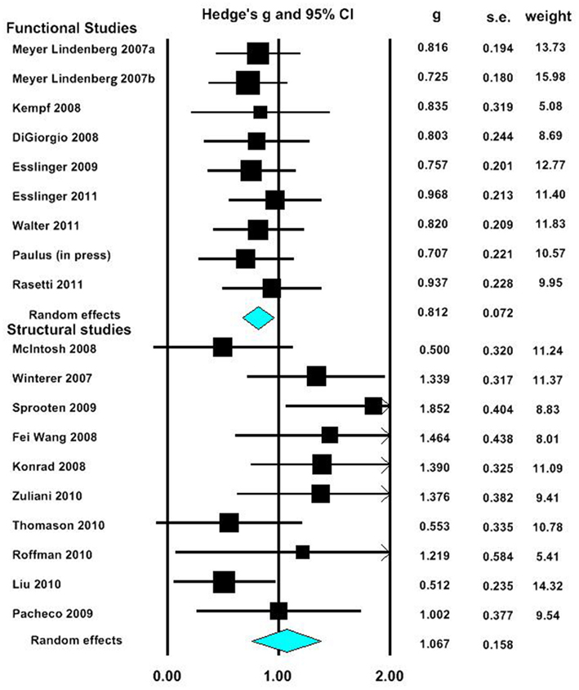
Example

Slide 31
Consulting Approach
Introduction to literature on statistical consulting.
First meeting with clients was arranged by professors.
Weekly meeting 4:30 – 6:00 PM
Concepts
Computation
Between meetings.
Research
Email to coordinate meetings
Created slides on statistical methods for presentation.

Slide 32
Consulting Process
Phase 1: Nutrient's students come with their thesis in the nutrition domain.
Phase 2: Review with them the research question and modify it to be a well-formulated research question that addresses correctly the research problem.

Slide 33
Phase 3: In-depth analysis of statistical procedures and guiding the students to the appropriate statistical test(s) that demonstrate the most effective approach for their type of data.
Phase 4: Work with them in the discussions and interpretations of research results and the best way to presented pictorially and in self-explanatory tables

Slide 34
Methods discussed
Article inclusion criteria
Detecting publication bias
Funnel Plot
Egger Test
Weighting studies
Size vs. precision
Coping with missing values
Reasonability of results
Bi-modal distribution

Slide 35
Consulting Form
STATISTICAL CONSULTATION REQUEST
Name: ________ Date of Request:____________
Phone: _______________
Email:______________
Please give a brief statement of your problem of interest
Is the project you are working on part of your
Degree requirement
Course requirement
Other(Please explain briefly using the space below)
Please identify the areas that you need assistance:
Study Design and Data Collection (Experiment setup, Survey Development, etc)
Sampling Technique and Sample Size Calculation
Statistical Data Analysis
Communicating the results
What is the approximate anticipated date of conclusion

Slide 36
Acknowledgements
Nutrition and Food Science Department for the consulting opportunity.
Departments of Mathematics and Statistics:
Head of the Department: Dr. Jeffery Fleming, all faculty and staff.
Statistical Consulting Course Instructors:
Dr. William Rice, and Dr. Valbona Bejleri.
Math lab technical staff Mr. Arlan Henry for his technical support.

Slide 37


